Slide 1



Unit 4: Week 1
Grade K

Slide 2
Copyright © Savvas Learning Company LLC. All Rights Reserved.
This publication is protected by copyright, and permission should be obtained from the publisher prior to any prohibited reproduction, storage in a retrieval system, or transmission in any form or by any means, electronic, mechanical, photocopying, recording, or otherwise. For information regarding permissions, request forms, and the appropriate contacts within the Savvas Learning Company Rights Management group, please send your query to:
Savvas Learning Company LLC, 15 East Midland Avenue, Paramus, NJ 07652
or
k12learningpermissions@savvas.com
myView Literacy® is an exclusive trademark of Savvas Learning Company LLC in the U.S. and/or other countries.

Slide 3
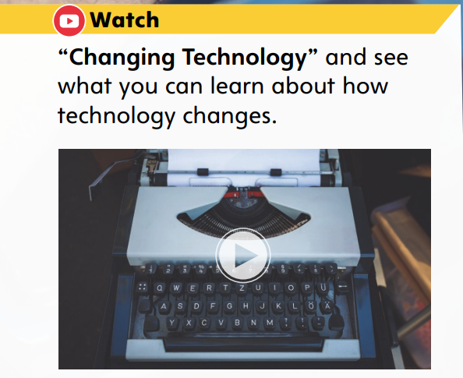


Page 8
Introduce the Unit
Essential Question: What can we learn from the past?
What technology do you use?
What did you hear and see in the video?
Notes:
Introduce the Unit 4 Essential Question: What can we learn from the past? Tell students that they will be reading many narrative nonfiction and fiction texts about the past and the present. Explain the importance of reading two different types of texts; each author discusses the theme, or important idea, in his or her own way. For example, the author of a narrative nonfiction text can use reallife examples to explore the theme, while the author of a fiction text can use characters and made-up events to talk about the theme.
Watch the Unit Video – Tell students that a video has both sound and pictures. It is important to pay close attention to both to get all of the information from the video. Have students listen to the sounds and watch the pictures as they view the Unit 4 video. Click Path: Table of Contents -> Unit 4: Then and Now-> Unit 4: Introduction
Have pairs of students discuss what they learned about technology in the past and the present by watching the video. Guide their discussions using the following questions:
What did you hear in the video?
What did you see in the video?

Slide 4
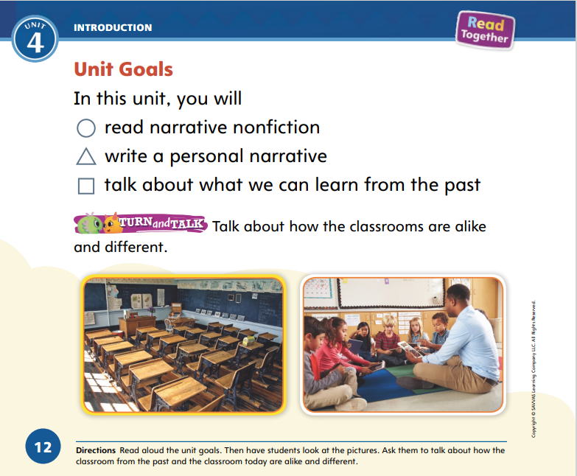
Page 12
    Unit Goals
Turn to page 12 in your
Student Interactive.
Color the shape next to
each goas as it is read.
Notes:
Read the Unit Goals on p. 12 in the Student Interactive to students.
As you read aloud each goal, have students shade in the shape next to it using different colors.
Using the photos on p. 12, hold a class discussion about classrooms from long ago and classrooms today.
Have students talk to a partner about how the classrooms in the pictures are alike and different.

Slide 5
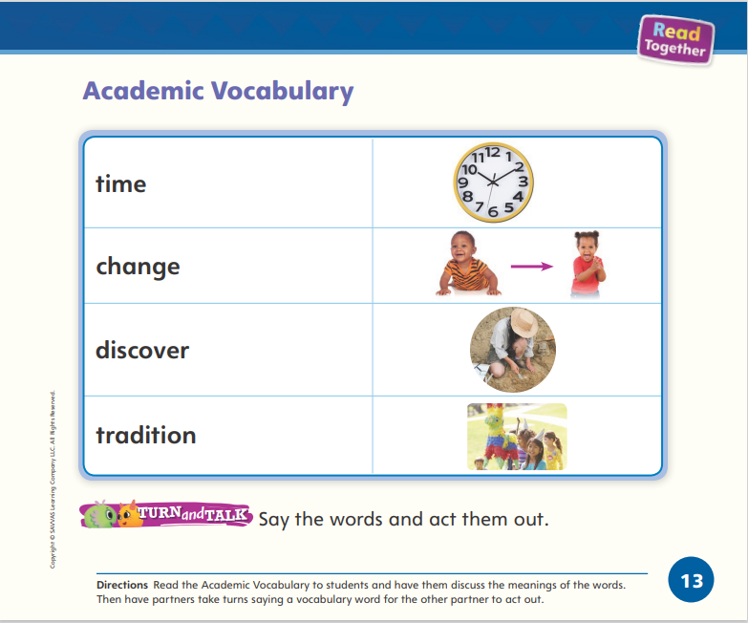
Page 13
Academic Vocabulary
Turn to page 13 in your Student Interactive.
Notes:
Remind students that academic language is used when discussing ideas. Tell them that as they learn about the past and present throughout the unit, they will learn and use these words.
Have students turn to p. 13 in the Student Interactive. Read aloud the words and the sentences below to model using the words.
Our tradition is eating dinner at the table every night.
You can discover seashells at the beach.
You change from a baby to a toddler.
The clock shows the time.
Then have students make up and say their own sentences using the new Academic Vocabulary words.
Guide students to recognize the connection between the pictures and words on p. 13. Have partners take turns saying the words and acting them out.

Slide 6
Lesson 1

Slide 7
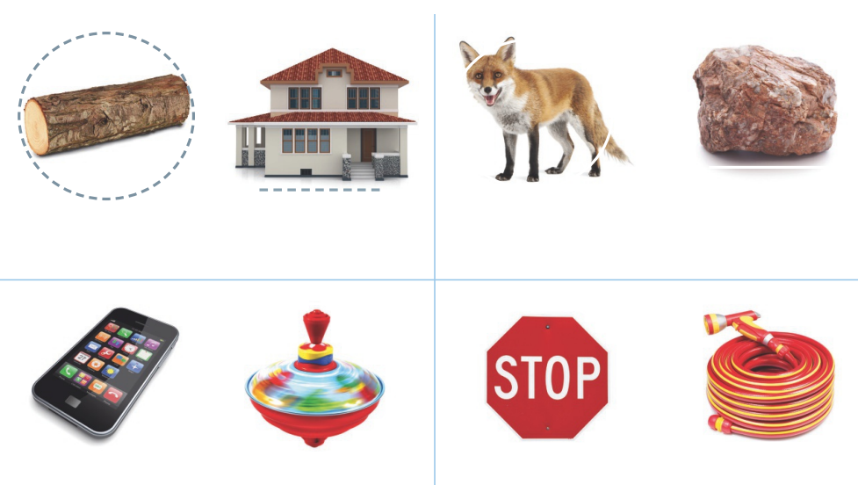
Page 16
Phonological Awareness
Notes:
Tell students that today they will learn a new sound. The new sound is /ō/. Let’s say it together: /ō/ /ō/ /ō/. Say the word tot. Let’s say this word together: /t/ /o/ /t/. The word is tot. The word tot has the sound /o/. If we change that sound to /ō/, we get the word tote. Let’s say it together: /t/ /ō/ /t/.
Have students turn to p. 16 in the Student Interactive. Say: Circle the picture words that have the sound /o/, and underline the picture words that have the sound /ō/. Let’s look at the first pair of pictures. I see a log and a home. In which word do you hear the sound /o/? Students should circle the picture of the log.
Ask: In which word do you hear the sound /ō/? Students should underline the picture of the home. Then have them finish the activity.

Slide 8


Phonics
o
o e
Notes:
Hold up the top Picture Card and point to the picture of the top. Have students say top with you. Turn the card over and read the word top with students. Let’s say the sound in the middle of the word: /o/ /o/ /o/. The middle sound /o/ can be spelled with the letter o.
Hold up the nose Picture Card, and point to the picture of the nose. Have students say nose with you. Turn the card over and read the word nose with students. Let’s say the sound in the middle of the word: /ō/ /ō/ /ō/. The middle sound /ō/ is spelled with the pattern o_e.
Write o and o_e on different sides of the board. Tell students that you will read a group of words, and they will listen for the sound /o/ or /ō/ in each one. They will walk to where the spelling for the sound they hear is written on the board. Use the following words: rob, robe, jog, bone, joke, log, mom, home, dot.

Slide 9
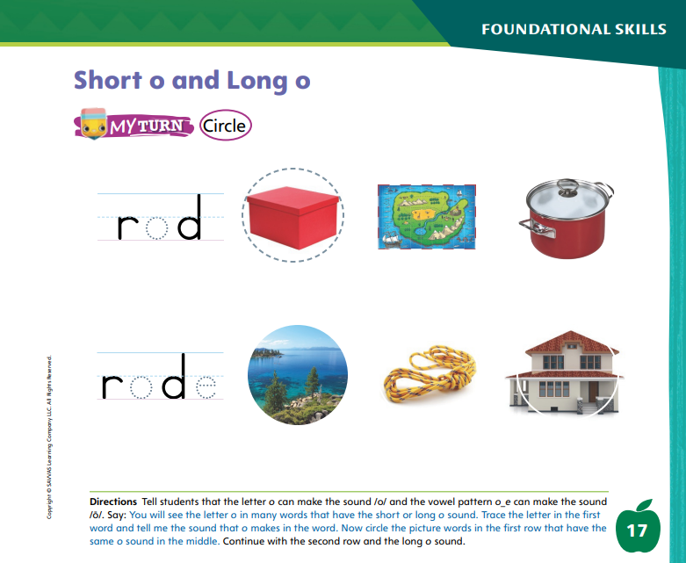
Page 17
Phonics
Turn to page 17 in your Student Interactive.
Notes:
Have students complete p. 17 in the Student Interactive.

Slide 10
High-Frequency Words
find
again
over
Notes:
Display the high-frequency words find, again, and over.
Show students familiar letter sounds, such as f/f/ in find, in these words.
Point to the word find and read it.
Have students point to the word find and read it.
Repeat for again and over.

Slide 11
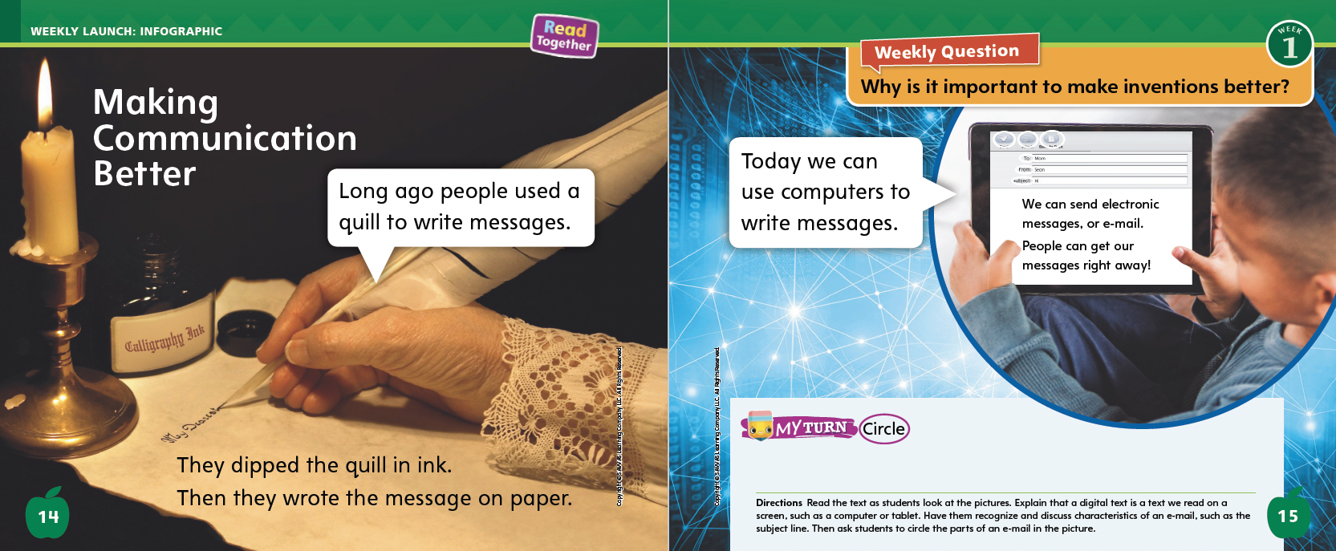
Page 14, 15
Interact with Sources
Why is it important to make inventions better?
Circle the parts of an e-mail.
Notes:
Prompt students to think about the Essential Question for Unit 4: What can we learn from the past? Then point out the Weekly Question: Why is it important to make inventions better? Explain to students that improving inventions is one way that things change over time. We can understand how inventions have changed by learning what they were like in the past.
Have students turn to p. 14 of the Student Interactive. Read the title aloud. Engage students in the topic by asking them what communication means. Guide them to recognize that communication is any way that people share information with each other.
Point to the picture on p. 14. Ask: What do you see on this page? (a pen that looks like a feather) Raise your hand if you have ever seen a pen that had to be dipped in ink. It is called a quill.
Point to the image on p. 15. Ask: What do you see on this page? (a tablet) Raise your hand if you have ever used a tablet. Did you use it to send an e-mail?
Read aloud the text on pp. 14–15. Tell students that the tablet is an example of a digital text. Explain that a digital text is text we can read on a screen. An e-mail is a characteristic form of digital text that provides a way to communicate by writing messages electronically. Ask students to think of other ways people communicate, such as talking face to face, talking on the telephone, texting on a smartphone, and using a webcam. Encourage students to share how they and their families communicate with relatives or friends who live far away.
Reread and discuss the e-mail in the picture on p. 15. Ask students to recognize characteristics of the digital text by circling parts of the e-mail, such as the lines showing who the message is going to, who it is from, the subject line, and icons to attach things.
Read aloud the Week 1 Question: Why is it important to make inventions better? Ask students why communicating by e-mail might be better than communicating with a quill and ink. Guide them to understand that current communication strategies are faster and more convenient. Then explain that this week they will read more about how inventions make life easier and how different forms of communication have changed over time.

Slide 12
Listening Comprehension
The Doctor’s Visit
1. Who is the text about?
2. Where and when does it take place?
Are the people, places, and things real?
Notes:
Tell students that you are going to read a narrative nonfiction text aloud. Narrative nonfiction texts have a main idea, and they inform the reader about something. They are also told as a narrative story.
Have students listen as you read aloud the narrative nonfiction text, “The Doctor’s Visit.” Tell students that they should listen actively by keeping their eyes on you and thinking about what you are reading aloud. Tell them to think about what they are learning as you read. Encourage students to ask and answer questions about key details in the story.
Read the entire text aloud without stopping for the Think Aloud callouts.
Reread the text aloud, pausing to model Think Aloud strategies related to the genre.
Think Aloud: “After you reread the first sentence, say: I can tell from the beginning that the person is telling about his or her experiences. I know this because the narrator uses the word I.”
Think Aloud: “After you reread this paragraph, say: This story seems like a real story. The words I and my help me to know that someone is writing about a real trip to the doctor.”
Use the chart to help students identify elements of narrative nonfiction.

Slide 13
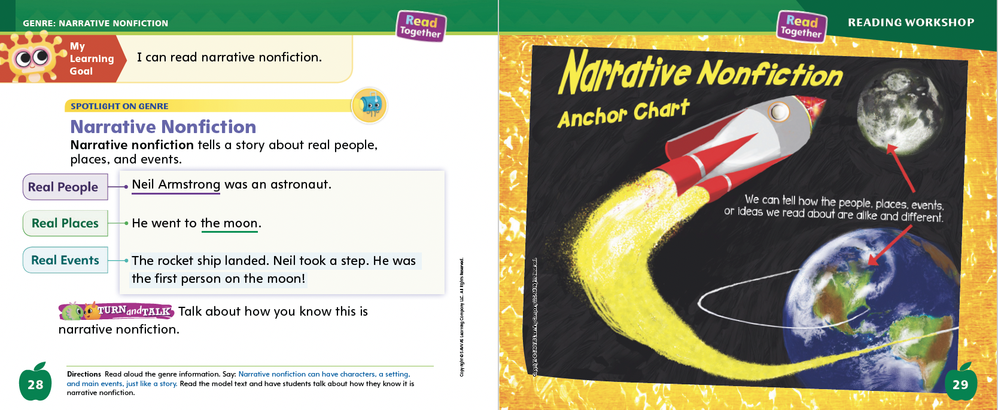
Page 28, 29
Narrative Nonfiction Qualities
Turn to page
28 in your Student Interactive.
Notes:
Tell students that narrative nonfiction tells a story. However, narrative nonfiction is different from some stories because the characters, places, and events are not made up.
The people are real people.
The places are real places.
The events really happened.
Narrative nonfiction can tell about people, places, and events from a long time ago or from today.
Ask students to raise their hand if they have heard of Neil Armstrong. Tell students that he was an astronaut. An astronaut is a man or woman who explores space. As I read, listen carefully. How can you tell this is a true story?
Have students turn to p. 28 of the Student Interactive and follow along as you read aloud. Guide students to recognize that the model text is about a real person and real events. If the story were about a dog flying a plane or people living on the moon, it would be fiction—or a made-up story. Editable Anchor Chart Click Path: Table of Contents -> Reading Anchor Charts -> Unit 4 Week 1: Narrative Nonfiction Editable Reading Anchor Chart

Slide 14
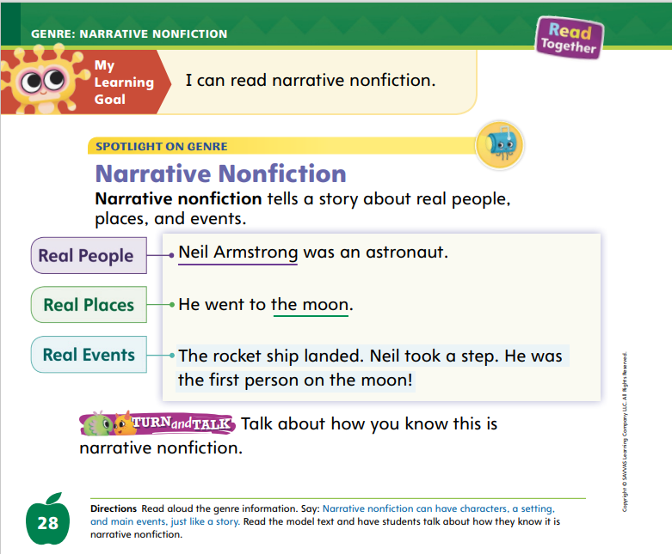
Page 28
Apply
Talk about how you know this is narrative fiction.
Notes:
Have students use the strategies to think about the people, places, and events of narrative nonfiction.
Have students turn and talk with a partner about how they know the story about Neil Armstrong is narrative nonfiction. Then have volunteers share their ideas with the class.

Slide 15
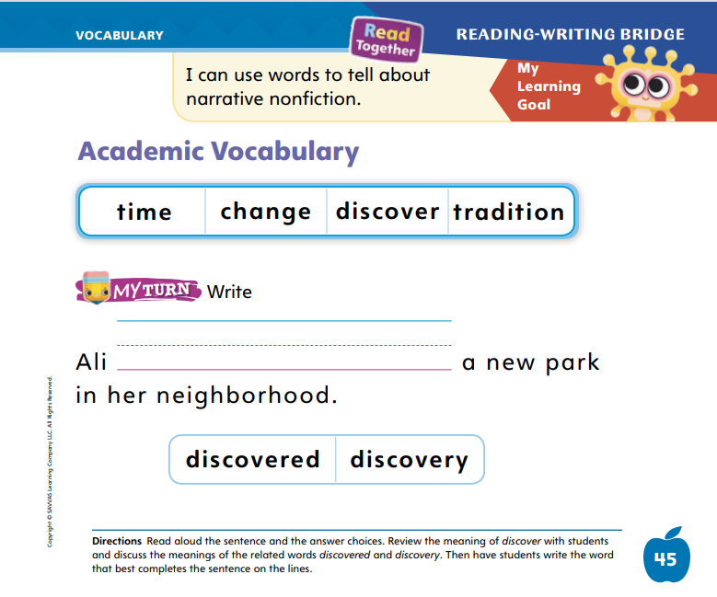
Page 45
Academic Vocabulary
happy
unhappy
Turn to page 45 in your Student Interactive.
Notes:
Remind students that related words are words that have similar meanings or word parts in common.
How are the two words alike? Do they share a word part?
How do the meanings of word parts affect the meanings of the related words?
Write the words happy and unhappy on the board. I know these words are related because unhappy has the word happy in it. The word part un- means “not.” Unhappy means “not happy.” Knowing related words can help readers figure out the meanings of new words.
Discuss the meanings of the words discover, discovered, and discovery. Use the words in oral sentences.
Read aloud the sentence on p. 45 of the Student Interactive and have students write in the word that makes sense.

Slide 16
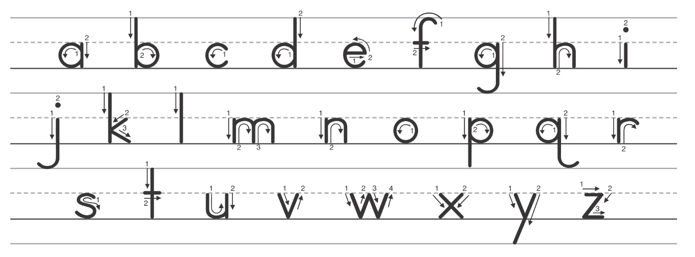
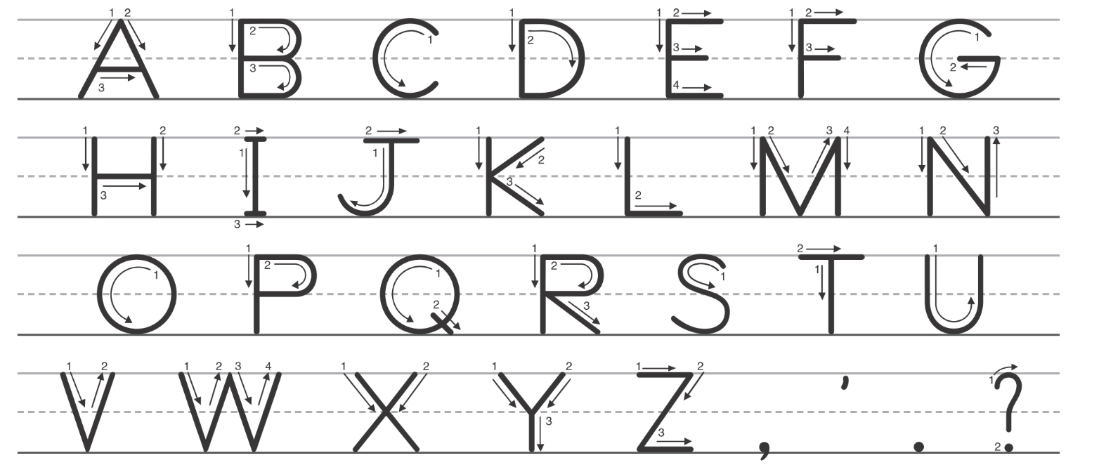
Handwriting
Notes:
Show students the alphabet and challenge them to find the letters Hh. Notice that the capital H looks different from the lowercase h. Do you see any letters that look like either of these letters?
Guide students to recognize that a lowercase h is similar to an n, which they already learned how to write.

Slide 17
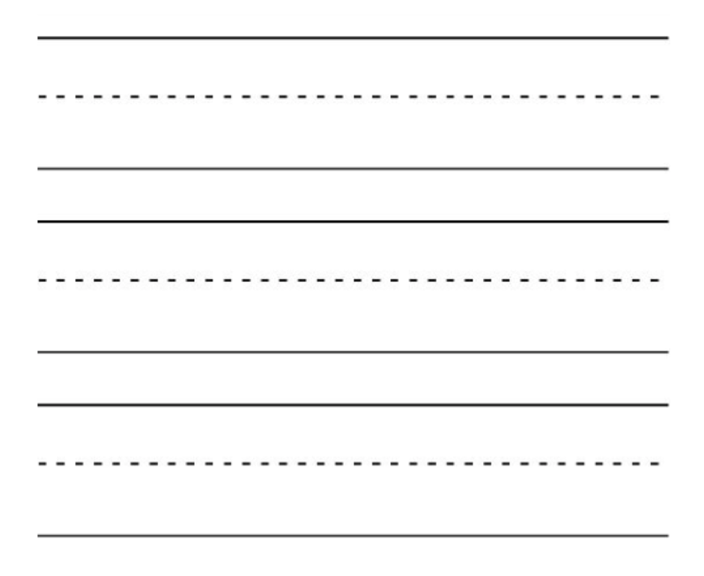
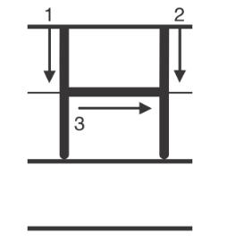

Handwriting
Notes:
Draw an uppercase H on the board as you explain how to make it. Remind students that a letter should always start at the top. Then draw a lowercase h on the board as you explain how to form it. Have students practice making the letters in the air, following your examples.
Have students use Handwriting p. 200 from the Resource Download Center to practice writing the letters Hh. Click path: Realize -> Table of Contents -> Resource Download Center -> Handwriting Practice -> U4W1L1 Handwriting Practice

Slide 18
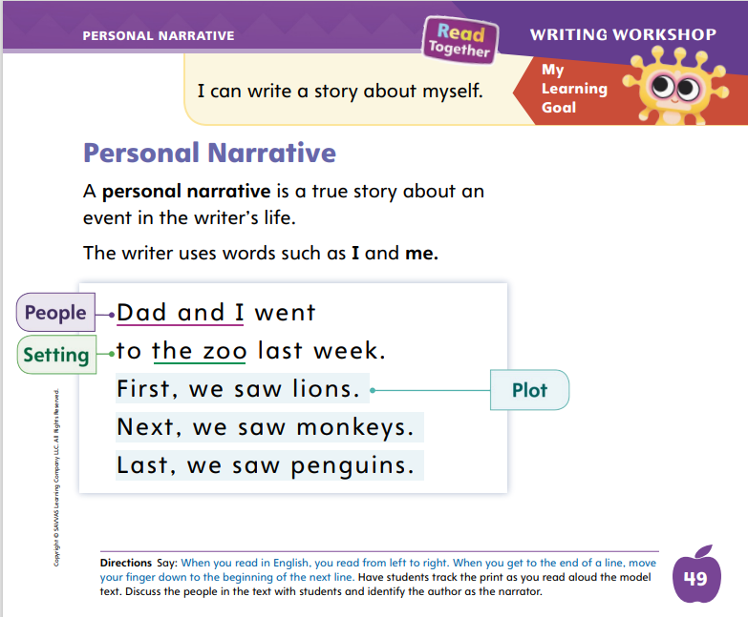
Page 49
Writing – Personal Narrative
Turn to page 49 in your Student Interactive.
Notes:
An author writes a personal narrative to tell a true story about an event that happened in his or her life. Personal narratives include real people and a real life setting. The author is writing about real events that happened.
Tell students that they will be exploring personal narratives over the next few days to prepare them to write their own. Today, they will explore a true story about an event in an author’s life, and they will learn what words authors use to tell a personal narrative.
Choose a book from the stack. As you read, show students how to hold the book right side up and read from left to right and top to bottom. Model this with your finger as you read aloud, including sweeping your finger from the end of one line to the beginning of the next line. When reading a personal narrative for the first time, emphasize the first-person words, such as I and me, that the author uses.
Use the following questions to discuss personal narratives:
Who is this story about?
Why do you think the author chose this event to write about?
What did you notice about the people, setting, and events in the story?
Direct students to p. 49 in the Student Interactive. Read through the instruction with them. Be sure to point out the use of I and we.

Slide 19

Independent Writing
Let’s look at some personal narratives.
Share a reason you like to read and write personal narratives.
Notes:
If students need additional opportunities to develop their understanding of personal narratives, they should read and look through additional books from the stack.
Writing Support
Modeled - Show a stack text and think aloud to identify elements of a personal narrative.
Shared - Have students choose a stack text to identify elements.
Guided - Use the stack text to provide explicit instruction on why authors write personal narratives.
If students demonstrate understanding, provide stapled booklets so they may begin writing their personal narratives.
Call on a few students to share a reason that they like to read and write personal narratives.

Slide 20
Spelling
A rabbit can hop.
The box is heavy.
Use the mop to clean the floor.
I need to find my book.
Can you come over and play?
I drew a dot on the page.
Notes:
(Note: Move the orange boxes to cover each bold spelling word before you read aloud the words and sentences.)
Read aloud the words and sentences. Have students spell each word with initial consonant blends and the two high-frequency words.
A rabbit can hop.
The box is heavy.
Use the mop to clean the floor.
I need to find my book.
Can you come over and play?
I drew a dot on the page.
Reveal the spelling word and have students check their work.

Slide 21
Language and Conventions
The book is on the table.
I play.
Practice using prepositional phrases to describe where or how.
Notes:
Remind students that prepositional phrases tell where or when something happens.
Model using this sentence: The book is on the table. Where is the book? The words on the table tell me where it is. That means on the table is a prepositional phrase and on is a preposition.
Have students complete the following directions and tell what the prepositional phrase is: Jump on one foot. (on one foot) Put your book under the desk. (under the desk) Point at the ceiling. (at the ceiling)
Provide students with a sentence that does not have a prepositional phrase, such as: I play. Ask them to add a prepositional phrase. Challenge students to think of new prepositional phrases that describe where, when, or how. Provide prepositions if needed. (Examples include: I play with my friends; I play on the playground; I play after school.)

Slide 22
Lesson 2

Slide 23

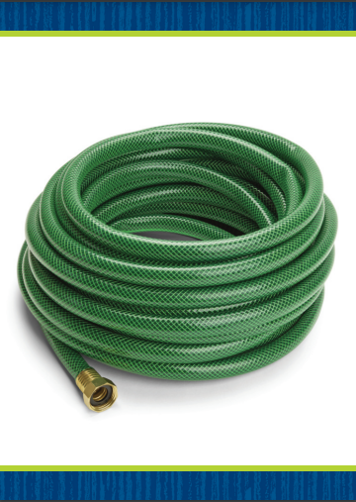
Phonics
Rob
Notes:
Display the box Picture Card. This is a picture of a box. Listen to the sounds in the word: /b/ /o/ /ks/. I hear the sound /o/ in the middle of box. Flip the card over and have students read the word with you. What letter spells the sound /o/? Students should say the letter o.
Hold up the hose Picture Card. This is a picture of a hose. Listen: /h/ /ō/ /z/. What sound do you hear in the middle? (/ō/) Flip over the card and have students read the word with you. What pattern spells the sound /ō/ in hose? Students should identify o_e
Write the word Rob on the board. Let’s read this word together. What is the sound for R? What is the sound for o? What is the sound for b? Now let’s blend the sounds together: /r/ /o/ /b/, Rob. Continue with these words: robe, joke, jot, smoke, mom.

Slide 24
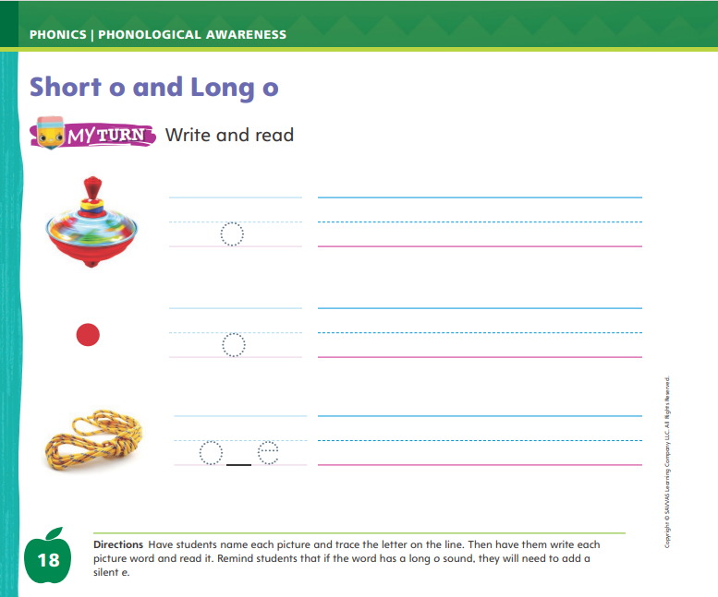
Page 18
Apply
Turn to page 18 in your Student Interactive and complete the activity.
Notes:
Have students complete p. 18 in the Student Interactive.

Slide 25
High-Frequency Words
find
again
over
Notes:
Tell students that high-frequency words are words that they will hear and see over and over in texts.
Write and read the words find, again, and over.
Have students read each word.
Have students spell each word, clapping as they say each letter.

Slide 26
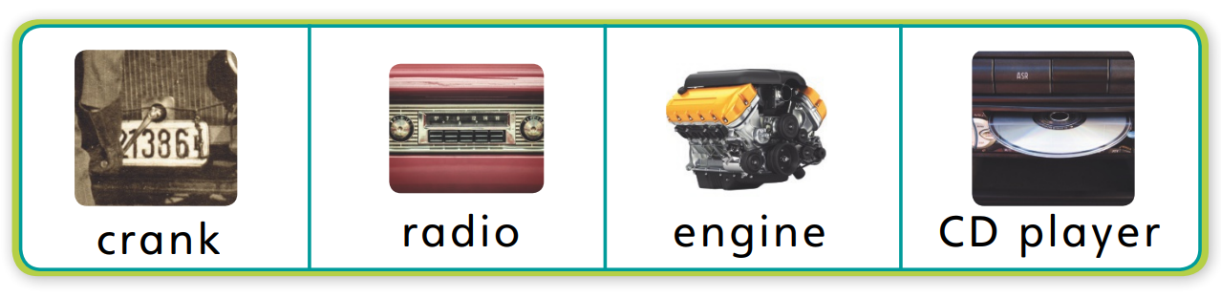
Page 30
Preview Vocabulary
Notes:
Tell students that before you read, you will look at some of the words they will see in the text. Introduce the words crank, radio, engine, and CD player on p. 30 of the Student Interactive. As you read each word, have students point to the picture.
Prompt students to share what they already know about the words. Ask questions such as: What can you hear on a radio? What do you put in a CD player? Name something with an engine.
Have students look at p. 30 in the Student Interactive. Guide them to recognize that sentences are comprised of words separated by spaces and recognize word boundaries. Have them point to the sentence under “Read.” Explain that the spaces help readers understand where one word ends and the next word begins. Have students point to each word in the sentence as you read it aloud. Then have them point to the spaces between the words. Continue with the sentences in the section “Meet the Author.”

Slide 27
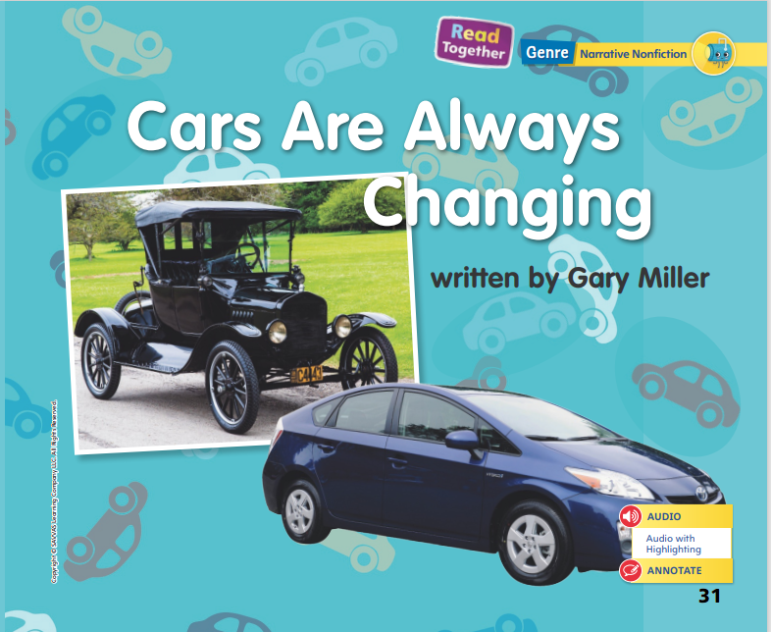
Page 31
First Read Strategies
Notes:
Discuss the First Read Strategies. For this first read, tell students to listen for what the text is mostly about. After students complete the First Read, ask: What did you like? What surprised you?
First Read Strategies
READ Read or listen to the text. During the first read, students should work to understand what the text is mostly about.
LOOK Look at the pictures to better understand the text.
ASK Ask questions about the text to deepen understanding.
TALK Talk to a partner about the text.
Students may read independently, in pairs, or as a class. Use the First Read notes to help them connect with the text and guide their understanding.

Slide 28
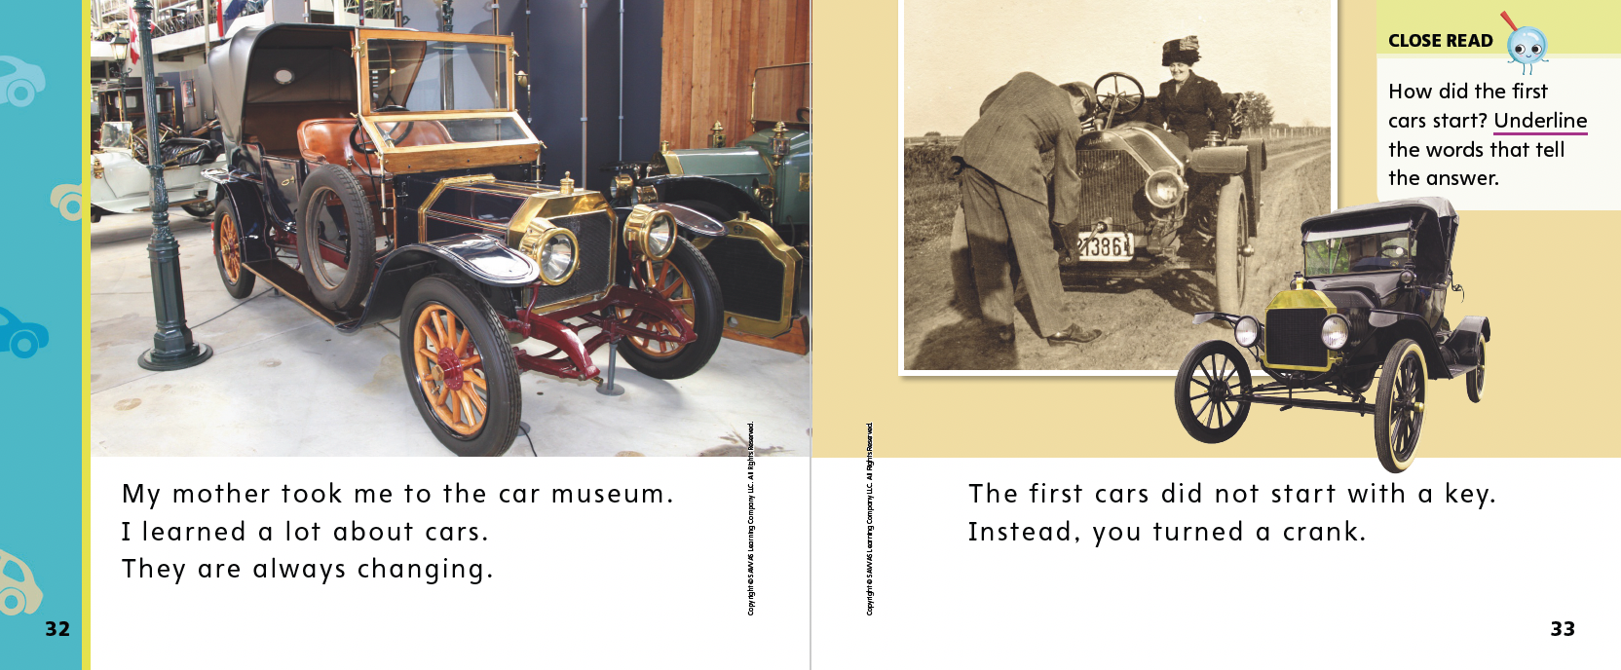

Page 32, 33
First Read – Cars Are Always Changing
Notes:
Read Together.
THINK ALOUD I can see from these pictures that the museum has old cars. The pictures show me how these old cars are different from cars today. Looking at the pictures helps me better understand the text.

Slide 29
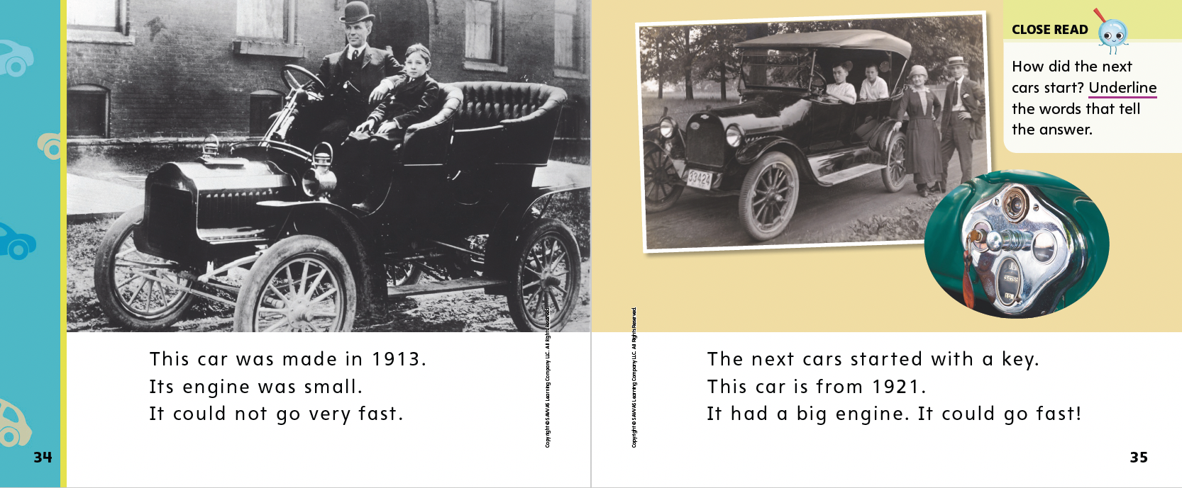
Page 34, 35
First Read – Cars Are Always Changing
Notes:
Read Together.

Slide 30
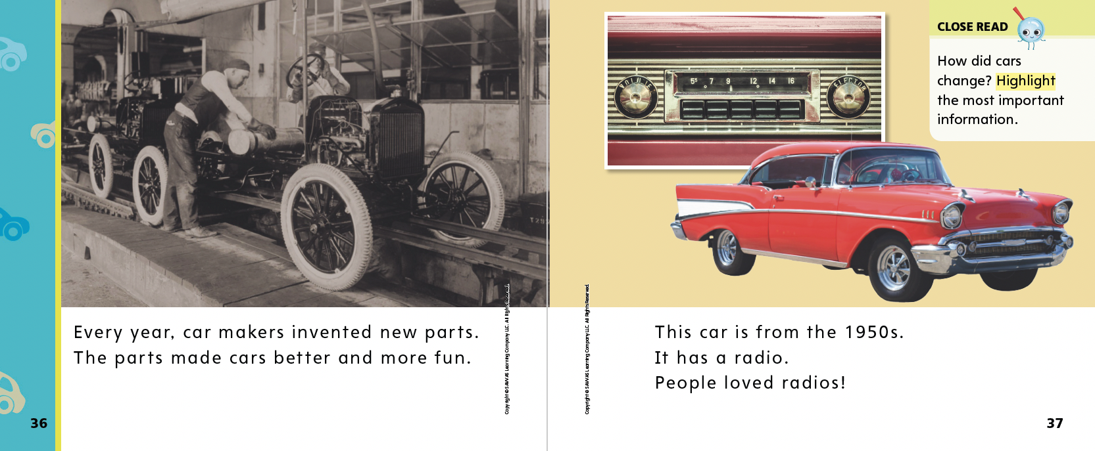
Page 36, 37
First Read – Cars Are Always Changing
Notes:
Read Together.

Slide 31
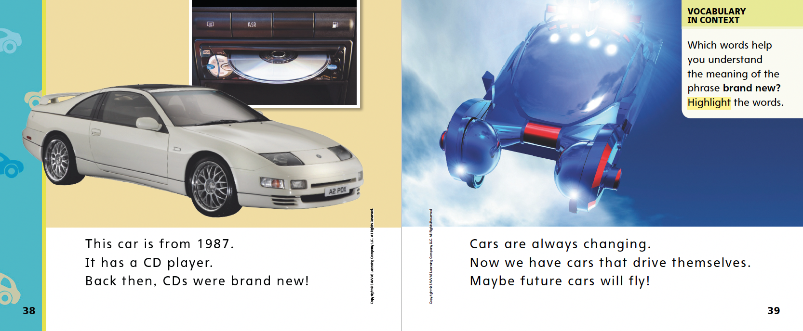
Page 38, 39
First Read – Cars Are Always Changing
Notes:
Read Together.
THINK ALOUD I read the term CD player, but I don’t know what that is. I am going to look closely at the text on p. 38 to see if I can figure it out. The text says that the car has a CD player. The text does not help me figure out the meaning of the term. If I look at the little picture above the car, I see something that looks familiar. My aunt has a car with this type of device in it—she puts in a disc to play music as she drives. I know that these discs are also called CDs. This must be a CD player!

Slide 32
Respond and Analyze
Talk: In the text, did you like the old cars or the new cars? Which car did you like the most?
Illustrate: Draw a picture show which change to cars you think was most important.
Notes:
Use these suggestions to prompt students’ initial responses to Cars Are Always Changing.
Talk Work with a partner. In the text, did you like the old cars or the new cars more? Which car did you like the most?
Illustrate Draw a picture to show which change to cars you think was the most important.

Slide 33
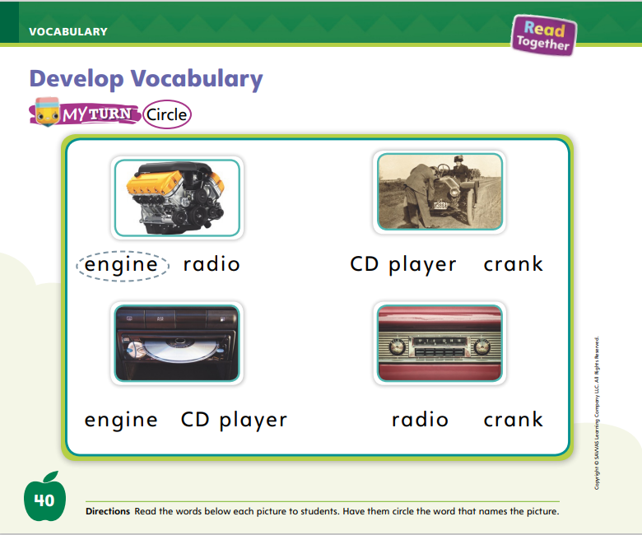
Page 40
Develop Vocabulary
Turn to page 40 in your Student Interactive and complete the activity.
Notes:
Tell students that the author chose words that tell about cars: crank, radio, engine, and CD player. Knowing the meanings of key words like these helps readers understand the big ideas in a text. Remind students to:
Think about words the author uses that tell something specific and important about the main idea.
Look at the pictures in the text and see if there are clues to help them learn or clarify the meanings of these key words.
Look at the words around a new word to see if there is an explanation to help them understand these key words better.
Have students turn to p. 40 in the Student Interactive. Model how to complete the activity using the photograph. Read aloud the two words under the photo, and ask students which word tells about the picture. Is this a picture of an engine or a radio? I know that an engine is the part of a car that makes it move. A radio plays music. This is a picture of an engine. I will circle the word engine.
Model circling the word. Then read the pairs of words under each picture and have students circle the correct word for each image.
Have students practice developing vocabulary by completing p. 40 in the Student Interactive.

Slide 34
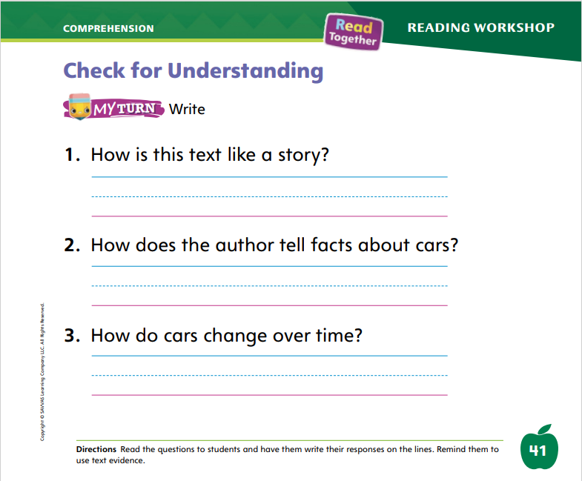
Page 41
Check for Understanding
Turn to page 41 in your Student Interactive and complete the activity.
Notes:
Have students complete the Check for Understanding on p. 41 of the Student Interactive.

Slide 35
Writing – Personal Narrative
Stop and Jot
Setting
Characters
Notes:
The characters and setting of a personal narrative are taken from real life. The characters are people from the author’s life. The setting is a real place the author has been.
Hold up a stack text. Explain that this story really happened. Read the story aloud. After reading, ask students to name the main character. If the story is told in first person, students may need help naming the author. Then ask students to name other characters in the story. Say: When we write our own personal narratives, you will be the main character because your story will be about something that happened to you. Who will your other characters be? Discuss what other people in real life might appear in students’ own personal narratives.
Follow the same process with setting. Explain that the setting is where and when a story takes place. Have students identify the setting in the stack text. Then discuss possible real settings for their narratives.
Read another stack text. Ask students to identify the characters and setting, using both the text and the pictures to gather information. Emphasize that the characters and setting in a personal narrative are from the author’s real life.

Slide 36
Independent Writing
Draw and label the characters and setting you plan to write about.
Share the setting of your personal narrative.
Notes:
If students struggle to understand characters and setting in personal narratives, give them more time to read books from the stack.
Have students draw and label the characters and the setting they plan to write about.
Writing Support
Modeled - Read a stack text aloud and point out the characters and setting.
Shared - Have students think of a story and explain the characters and setting.
Guided - Prompt students to add details to their pictures of their characters and setting.
If students demonstrate understanding, let them begin or continue writing or drawing their personal narratives.
Call on a few students who have started to write. Ask them to share the setting, or the time and place, of their personal narrative.

Slide 37
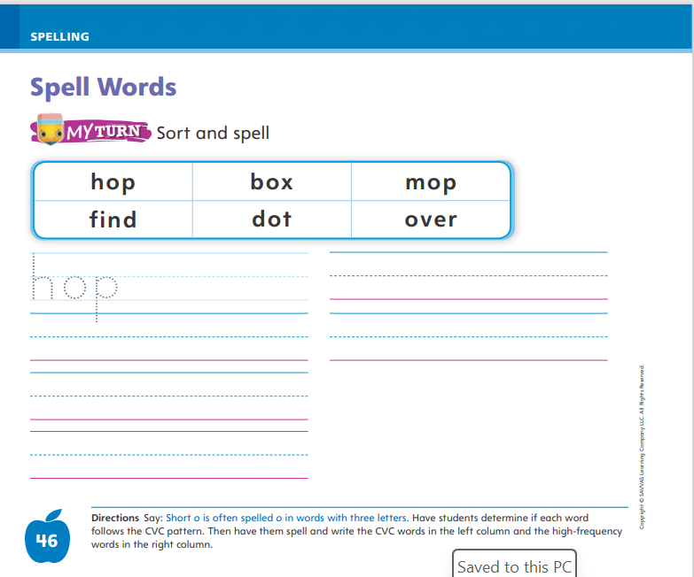
Page 46
Spelling
Turn to page 46 in your Student Interactive and complete the activity.
Notes:
Practice the short o sound with students. Help them recognize that many words with short o are spelled with the letter o between two consonants.
Have students turn to p. 46. Point out the following words: hop, box, dot, mop. These words have a CVC pattern and the short vowel o. I can use that to spell these words correctly. Ask students to read aloud each word, paying attention to letters and spelling patterns.
Have students complete the activity on p. 46.

Slide 38
Language and Conventions
The dog.
Runs.
The dog runs.
Identify complete sentences.
How can we make a complete sentence from fragments?
Notes:
Tell students that sentences tell ideas. A complete sentence has a noun (a naming part) and a verb (an action part).
Say incomplete sentences for students. For example, say: The dog. This is not a complete sentence because it does not have a verb, or action part. Runs. This is not a complete sentence either because it does not have a noun, or naming part. The dog runs. This is a complete sentence. It has both a noun and a verb.
Provide students with sentences and sentence fragments. Have them identify whether they are complete sentences. If needed, review each sentence fragment and talk about the part of the sentence that is missing.

Slide 39
Lesson 3

Slide 40
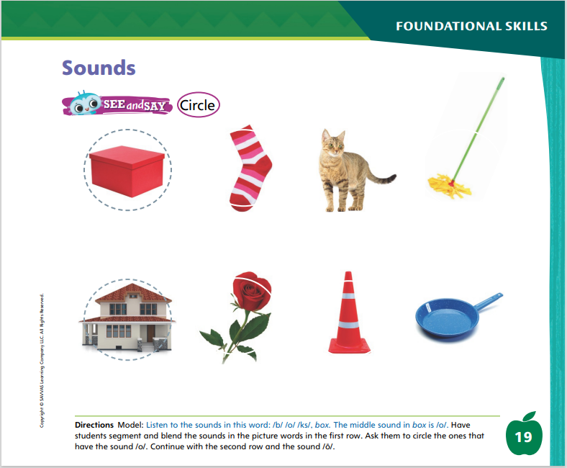
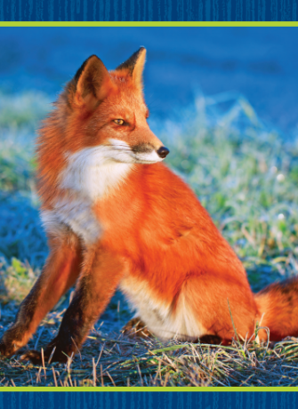
Page 19
Phonological Awareness
Notes:
Display the fox Picture Card. This is a picture of a fox. Listen to the sounds as I say this word slowly: /f/ /o/ /ks/. How many sounds does the word /f/ /o/ /ks/ have? Yes, it has three sounds. Now listen as I blend the sounds together to say the word: fox. Have students segment and blend the sounds in fox with you.
Have students point to the picture of the box on p. 19 in the Student Interactive. Listen to the sounds in this word: /b/ /o/ /ks/, box. The middle sound in box is /o/. In this row, we will circle picture words with the middle sound /o/. Let’s circle the box.
Have students segment and blend the sounds for each picture word in the first row and circle the ones that have the sound /o/. Then continue with the second row and the sound /ō/.

Slide 41
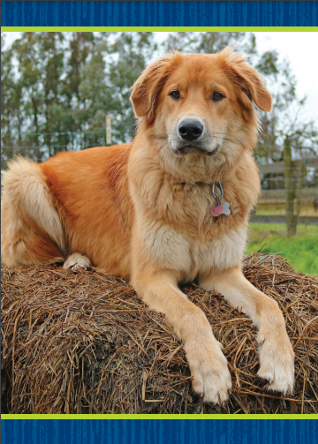
Page 20
Phonics
Turn to page 20 in your Student Interactive and complete the activity.
Dog
Notes:
Tell students that the sound /o/ can be spelled with the letter o and that the sound /ō/ can be spelled with the vowel pattern o_e. Display the dog Picture Card. Point to the picture of the dog. Write dog on the board and read the word aloud. Tell students the word dog has the middle sound /o/ spelled o. Repeat with the hose Picture Card for the sound /ō/ spelled o_e.
Have students turn to p. 20 in the Student Interactive. Ask them to trace the letters and read the words. Then tell students the first picture is a cone. Have students identify if cone has the sound /o/ or /ō/. Tell students if the word has the middle sound /o/ like fox, they should color the circle red. If the middle sound in a picture word is /ō/ like home, they should color the circle blue.
Identify all the pictures on p. 20 with students, and then have them complete the activity.

Slide 42
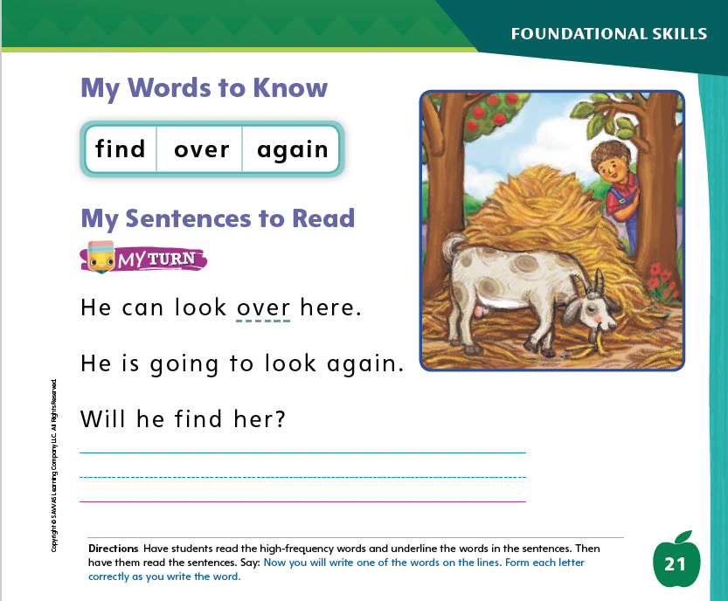
Page 21
High-Frequency Words
find
Turn to page 21 in your Student Interactive and complete the activity.
again
over
Notes:
Say: Today we will practice reading the high-frequency words find, over, and again. Have students read the words at the top of p. 21 in the Student Interactive with you: find, over, again.
Have students look at the words at the top of p. 21. Say: I will read a word, and I want you to point to it. Then we will read the word together. Read find, and have students point to it. Now let’s read the word together: find. Repeat with the other words.
Have students read the sentences on p. 21 with you. Ask them to identify the words find, over, and again in the sentences. Then have them read the sentences with a partner and underline the high-frequency words in the sentences. Finally, have them write one of the words on the line.

Slide 43
Page 31
Describe Connections
Notes:
Explain that each sentence in a text gives information, and these pieces of information are connected. An author does not write about one topic in one sentence and a totally different topic in another sentence. Readers describe connections between different pieces of information in a text. To make connections, students can:
Notice information that is about the same topic or theme.
Pay attention to ways in which different pieces of information tell different things about the topic.
Look at the title and ask: What does the title tell me about the topic?
Remind students that they just read a narrative nonfiction text about cars. Have them turn to p. 31 in the Student Interactive. Read the title aloud. I can tell from the title that the author wants me to know that cars are always changing. There are pictures of an old car and a new car. This means the text will be about changes in cars. I will look for ways to connect old and new cars, such as how they are alike and different.
Direct attention to p. 33 and read it aloud. This page tells about old cars. It tells how old cars are different from cars that came later. My car starts with a key, but this page tells me that old cars started by turning a crank.
Continue by having students identify information about old cars and new cars. Encourage them to find similarities and differences between them. Then point out the Close Read notes on pp. 33 and 35, and guide students to underline parts of the text that help them describe connections.

Slide 44
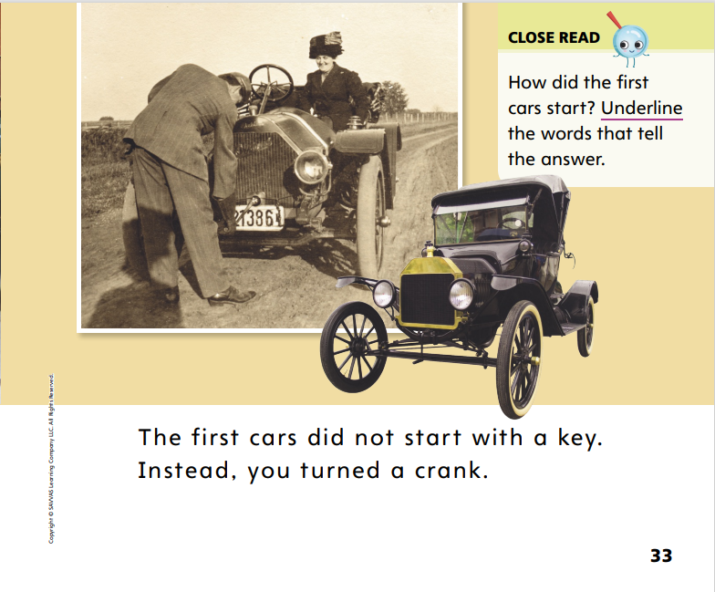
Page 33
Close Read – Describe Connections
Turn to page 33 in your Student Interactive.
Notes:
Tell students that authors connect information in a text. Read aloud the Close Read questions on p. 33 and p. 35. Guide students to find and underline the answers. This text evidence will help them describe connections in the text. DOK 2

Slide 45
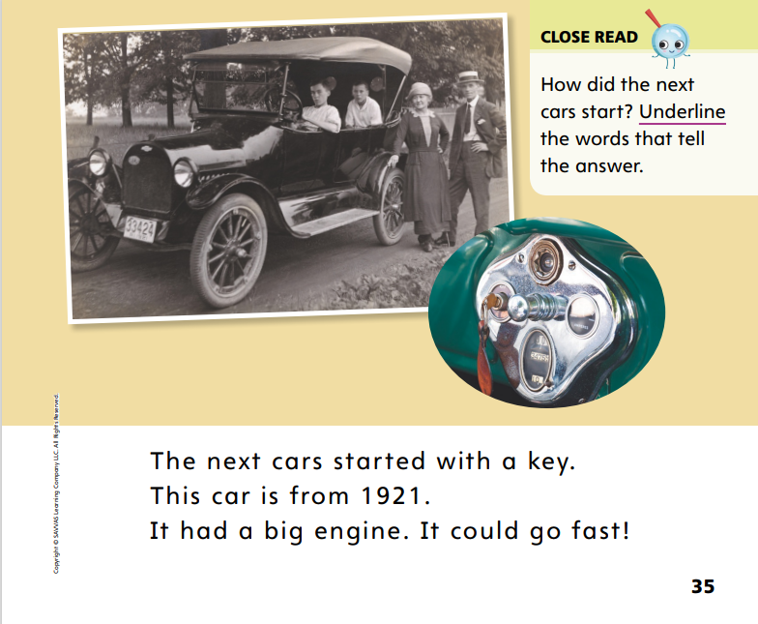
Page 35
Close Read – Describe Connections
Turn to page 35 in your Student Interactive.
Notes:
Tell students that authors connect information in a text. Read aloud the Close Read questions on p. 33 and p. 35. Guide students to find and underline the answers. This text evidence will help them describe connections in the text. DOK 2

Slide 46
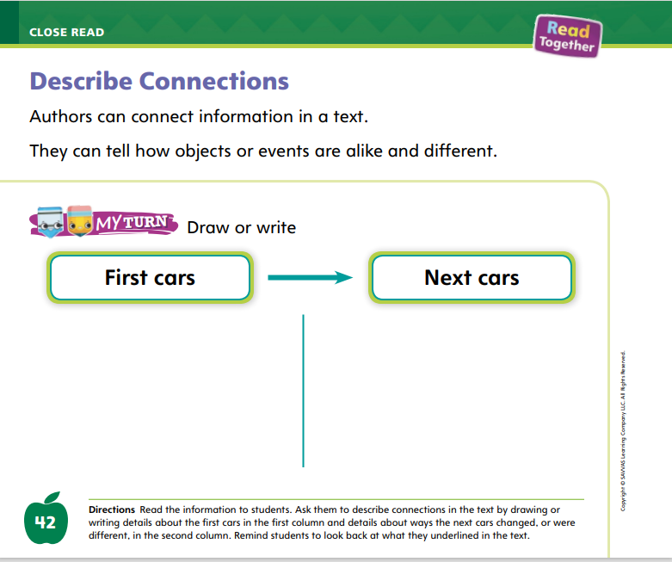
Page 42
Describe Connections
Turn to page 42 in your Student Interactive and complete the activity.
Notes:
Have students use the strategies for describing connections.
Read the directions at the bottom of p. 42 in the Student Interactive. Then ask students to describe connections by drawing or writing information about the first cars in the first column and information about ways the cars changed or were different in the second column. Encourage students to look back at the pictures and what they underlined in the text.

Slide 47
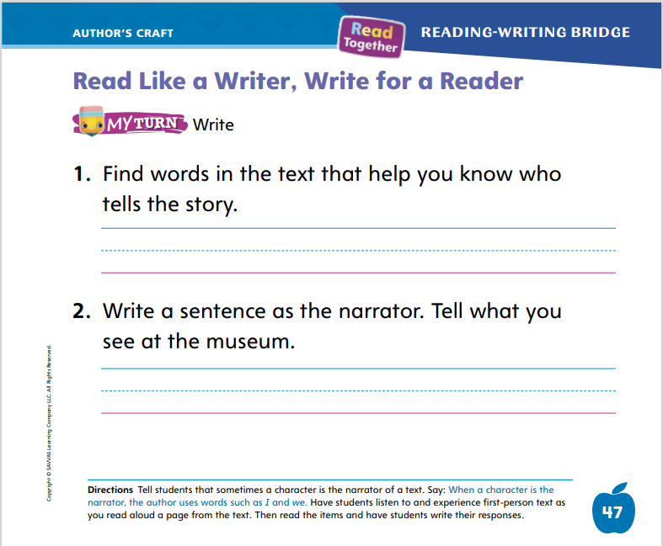
Page 47
Read Like a Writer, Write For a Reader
Turn to page 47 in your Student Interactive and complete the activity.
Notes:
Tell students that different people can tell a story. If I write about Lily’s day at school, I am telling Lily’s story. If I write about my day, I am telling my own story. That means I am the narrator. This is called first-person text. The pronouns I, me, my, we, us, and our are words that show that I am telling my own story.
Model first-person text. Display and read aloud this sentence: Last night I watched a movie. In this sentence, I am telling my own story. I use the word I. This is first-person text. Have students take turns telling a first-person story and naming the pronouns they hear.
Have students complete p. 47 in the Student Interactive.

Slide 48
Handwriting
It is hot.
Notes:
Tell students they are going to practice writing words. Point out that words are made up of several letters. Explain that there are no spaces between letters in a word, but there are spaces between words.
Display this sentence: It is hot. I see three words in this sentence. I see a space between the words. I do not see spaces between the letters within the words. Place your finger between the words to show there is a space between them.
Provide students with lined paper. Help them recognize the difference between a letter and a printed word by having them copy and write the sentence: It is hot. Ask them to make sure they have left a space between words by putting their finger between the words.
Have students use Handwriting p. 201 from the Resource Download Center to practice writing simple words. Click path: Realize -> Table of Contents -> Resource Download Center -> Handwriting Practice -> U4W1L3 Handwriting Practice

Slide 49
Writing – Personal Narrative
Plot
Can you guess what a plot is?
Notes:
The plot of a personal narrative includes the events that make up a story. The events are usually told in the order that they happened.
Explain that in a personal narrative, an author writes about events that happened in real life. Those events are called a plot. Read a stack text aloud. When you are finished reading, have students recall the plot. Flip through the book to help them. As they name events, write the events on the board. Say: In a personal narrative, the events are told in the order they happened—first, next, and last. When we write our own narratives, we will write what happened in the order that it happened in real life.
Read another book from the stack, or have students think about a personal narrative they have already read as a class. Call on students to name the events from the story. Help them retell the events in order.
Tell students that small moments usually make the best personal narratives. Think aloud about a small moment, and write the events you could include in your story. For instance: I remember taking a bike ride with my mom. First, we put on our helmets. Then we rode our bikes down the street. Next, we went down a big hill! I asked Mom if we were lost, but she told me she knew where we were going. Finally, we turned a corner, and we were at the park!

Slide 50
Independent Writing
Think about a small moment and write events you could include in your story.
Share the first event of your personal narrative with the class.
Notes:
If students need more time to understand how authors write and draw personal narratives, have them continue reading the stack texts.
Writing Support
Modeled - Read a stack book aloud and identify the sequence of events in the plot.
Shared - Have students tell the plot of their favorite story.
Guided - Encourage students to identify their plot events in detail.
If students show understanding, have them work on their own personal narratives.
Have a few students share the first event of their own personal narratives. Then ask what might happen next.

Slide 51
Spelling
pot
got
cot
fox
Notes:
Remind students that when words have a short o sound, they are usually spelled with the letter o between two consonants.
Have students practice spelling CVC words with short o as you read a list of words. Use the following words: pot, got, cot, fox.
Have students complete Spelling p. 210 from the Resource Download Center. Click path: Table of Contents -> Resource Download Center -> Spelling -> U4W1

Slide 52
Language and Convention
The boy opened the door.
A bus honks its horn.
Find the noun, verb and capital letter at the beginning of the sentences.
Notes:
Remind students that a complete sentence has a naming part and an action part. The naming part has a noun or pronoun. The action part has a verb.
Write this sentence on the board: The boy opened the door. I can see that this sentence has a naming part: The boy. Underline this part of the sentence and point to the noun boy. The sentence also has an action part: opened the door. Circle this part of the sentence and point out the verb opened.
Point out that the sentence begins with a capital letter. The capital T tells me that this is the beginning of the sentence.
Repeat this procedure with the sentence: A bus honks its horn. Ask a volunteer to point out the noun, verb, and capital letter at the beginning of the sentence.

Slide 53
Lesson 4

Slide 54
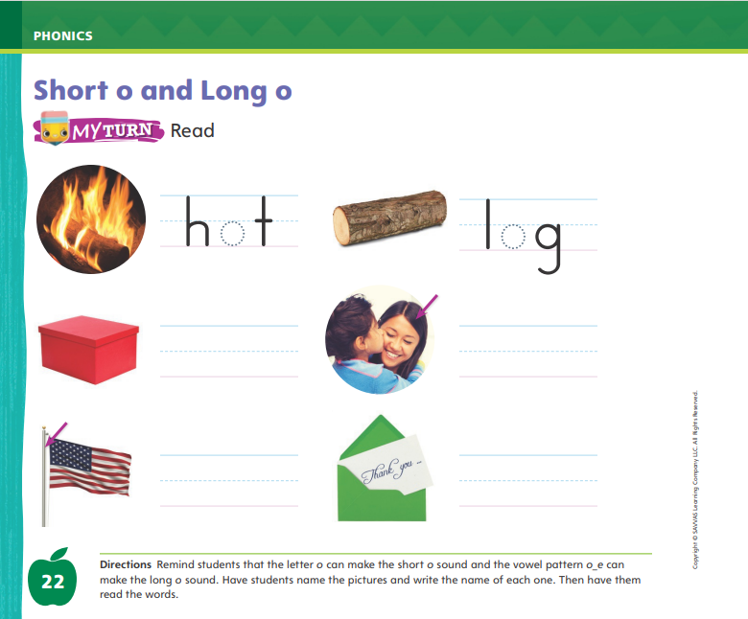
Page 22
Phonics
Turn to page 22 in your Student Interactive and complete the activity.
mop
rope
Notes:
Show students a mop and write mop on the board. Say: This is a mop. I hear the sound /o/ in the middle of mop. Say the sound /o/ with me. Point to the o in the word mop and say /o/. Do you hear the sound /o/? What letter spells the sound /o/? Have students identify the letter o.
Show students a jump rope and write rope on the board. This is a rope. I hear the sound /ō/ in the middle of rope. Say the sound /ō/ with me. Point to the vowel pattern o_e in the word rope and say /ō/. Do you hear the sound /ō/? What letters spell the sound /ō/? Students should identify the vowel pattern o_e.
Write fox and box on the board. Let’s read these words together: /f/ /o/ /ks/, fox; /b/ /o/ /ks/, box. Both words have the sound /o/ in the middle. What letter spells the sound /o/? (the letter o) Repeat with the words hope and joke for /ō/ spelled o_e.
Have students complete the activity on p. 22 in the Student Interactive.

Slide 55
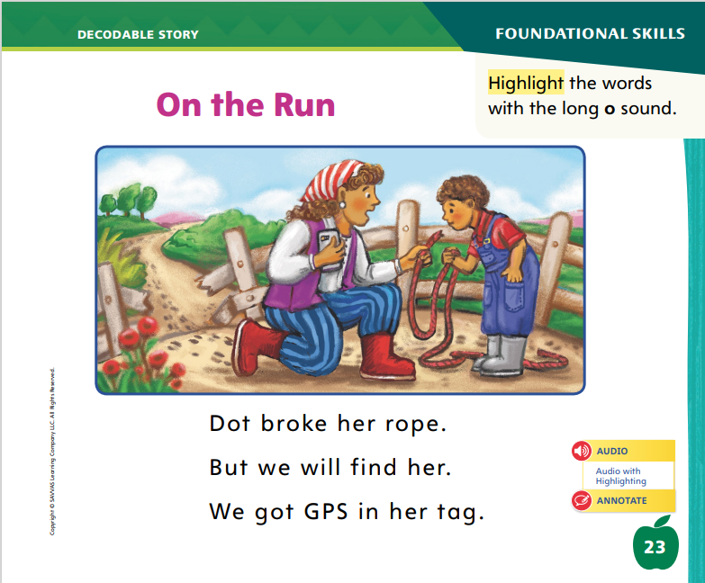
Page 23
Decodable Story
we
look
here
Turn to page 23 in your Student Interactive. We will Read “On the Run.”
Notes:
Have students turn to p. 23 in the Student Interactive. We are going to read a story today about a lost goat. Point to the title of the story. The title of the story is On the Run. I hear the sound /o/ in the word On. In this story, we will read other words that have the sound /o/. We will also read some words that have the sound /ō/. You may wish to point out to students that although the word goat has the long o sound, it is not spelled with the pattern o_e.
Remind students of this week’s high-frequency words: find, again, over. Tell them they will practice reading these words in the story On the Run. Display the words. Have students read them with you. When you see these words in the story On the Run, you will know how to identify and read them. You will also come across other high-frequency words you have learned: we, her, look, here.
Have students whisper read the story as you listen in. Then have students reread the story page by page with a partner. Listen carefully as they use letter-sound relationships to decode. Partners should reread the story. This time the other student begins.
After students have read the story, call their attention to the title. I see the letter O in this word. What are the sounds for o? Help them identify, or say, the sounds /o/ and /ō/. How do I know which sound this o spells? That’s right, there isn’t an e at the end of the word, so it must be /o/. Then have them read the word On in the title on p. 23.
Call students’ attention to the first sentence on p. 23. Which words include the sound /ō/? Point to them. Help students identify, or say, the sound /ō/. Then have them find and read the words: broke, rope. Have students highlight the words with the sound /ō/.

Slide 56
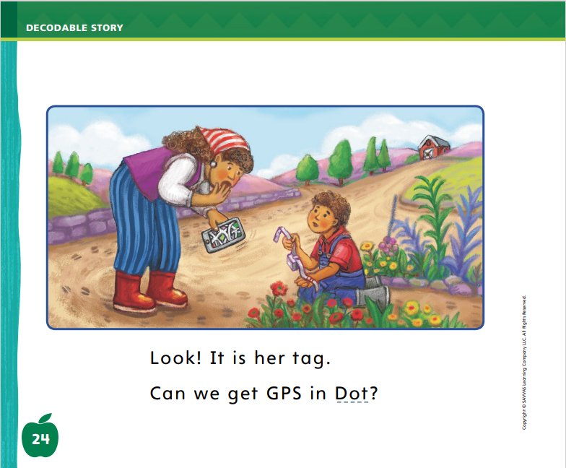
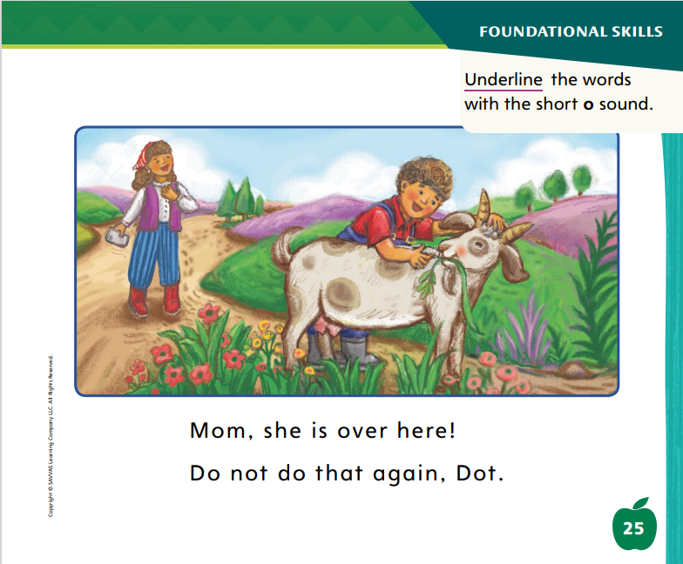
Page 24, 25
Decodable Story
Notes:
Have students turn to pp. 24–25 of the Student Interactive. Which words include the sound /o/? Point to them. Help students identify, or say, the sound /o/. Then have them find and underline the words with the sound /o/.
Have students tell you the high-frequency words they see on these pages.

Slide 57
Page 31
Find Important Details
Turn to page 31 in your Student Interactive.
Notes:
Explain that authors write details to tell about the topic. Say: Some details are important and help us understand the text. Other details are less important––the author may have included them to make the text more interesting. As you read, decide whether a detail helps you understand the text. If it isn’t helpful, then it probably isn’t important.
To evaluate details and determine which ones are most important, students can ask themselves:
Did this detail help me understand the text?
Was this detail interesting but not helpful?
Are there illustrations to support the detail?
Direct students to p. 37 in the Student Interactive: I can tell from looking at the pictures and reading the text that cars in the 1950s had radios. This is an important detail. It is shown in the picture and stated in the text, and it helps me understand how cars changed. The sentence “People loved radios!” is not important. It doesn’t help me understand how cars changed.
Direct students to the Close Read note on p. 37. Have them find and highlight the most important detail on pp. 36–37.

Slide 58
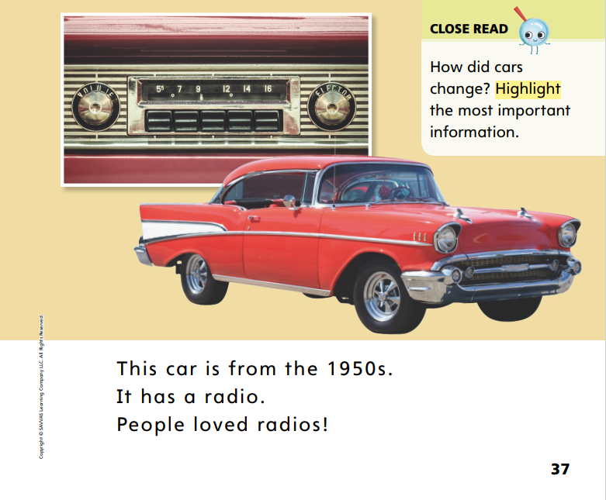
Page 37
Close Read – Find Important Details
Turn to page 37 in your Student Interactive.
Notes:
Read aloud the Close Read note on p. 37.
Ask students to highlight a detail that tells more about the topic and then share with a partner how they know it is important. DOK 3

Slide 59
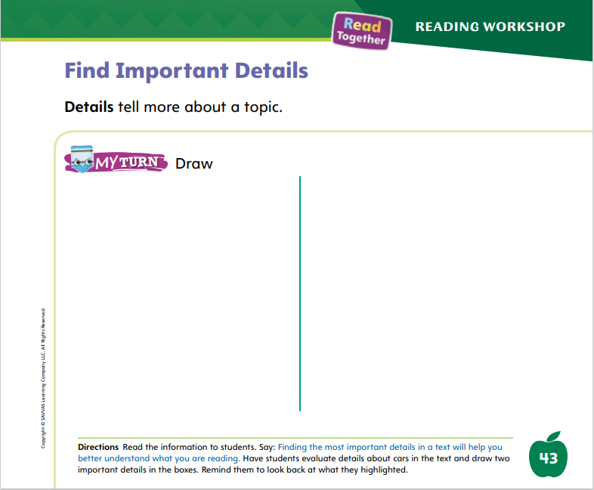
Page 43
Find Important Details
Turn to page 43 in your Student Interactive and complete the activity.
Notes:
Have students use the strategies for finding important details.
Read aloud the directions on p. 43 of the Student Interactive. Then have students draw pictures to demonstrate understanding of important details.

Slide 60
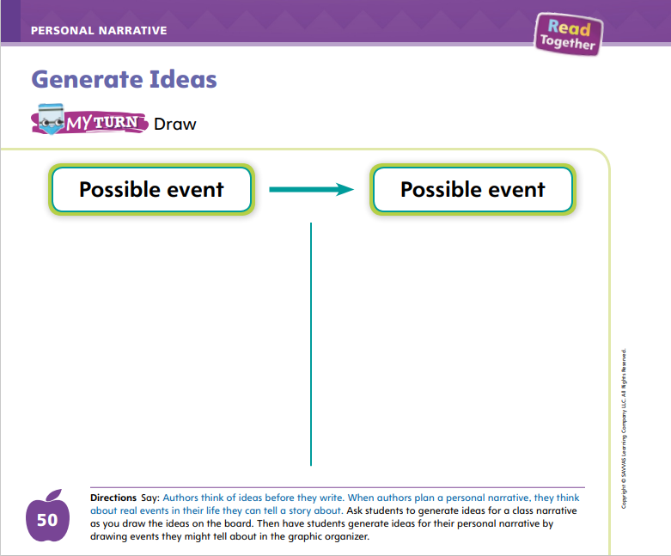
Page 50
Writing – Personal Narrative
Turn to page 50 in your Student Interactive.
Notes:
Authors can brainstorm ideas by drawing. Ideas for personal narratives come from an author’s life. Authors brainstorm ideas based on something interesting that happened in their lives. They might write about something interesting they learned and can teach others.
Read a stack text and discuss how the author might have come up with the idea. Then tell students you would like to write a personal narrative, but you are not sure which event in your life might make a good story. Briefly engage students in a discussion about the elements of a story, including setting, characters, and plot. Recall that these things must be memorable so that readers keep reading the story.
With students, brainstorm ideas for a personal narrative. Tell them to recall a small moment in their life that had interesting people, events, or setting. As they name small moments, write their ideas on a board or flipchart. Provide examples if students struggle, such as: my first day of school, the day I got my pet, skateboarding with a friend, riding my bike.
During brainstorming, prompt students with questions to generate ideas:
Have you ever gone on a fun trip? What happened?
What do you like to do with your friends?
What is the funniest thing that has happened to you?
Direct students to p. 50 in the Student Interactive. Tell them that generating their ideas through drawing is a good way to brainstorm. Explain that they should draw a lot of ideas on this page. Later, they will choose their favorite idea to write about. Tell them that they can return to this page later in the unit when they decide to start another book.

Slide 61
Independent Writing
Now you will begin writing your personal narrative.
Share your ideas and some of the events you will write about with the class.
Notes:
After this lesson, students should begin writing their personal narratives if they have not done so already.
Writing Support
Modeled - Discuss the main event of a stack text.
Shared - Prompt students to generate ideas by looking through the stack texts or class library.
Guided - Have students think about an event in their life to write about.
Ask one or two students to share their ideas and some events with the class. Prompt students to talk about why they chose that idea.

Slide 62
Spelling
find
again
over
Notes:
Have students recall previously learned high-frequency words.
Model spelling the high-frequency words find, again, and over by remembering the letters. Then give students letter cards to help them practice spelling the words.
Have students work in pairs to practice spelling high-frequency words.

Slide 63
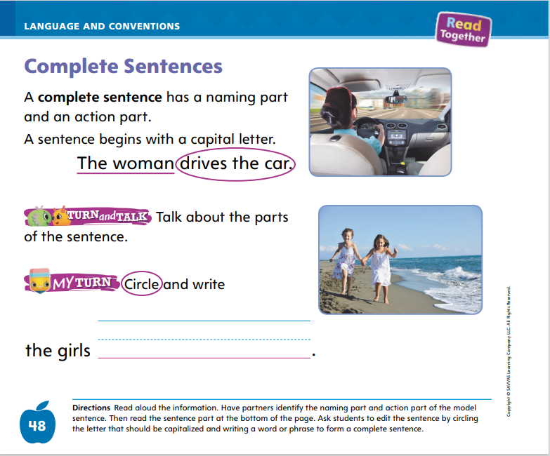
Page 48
Language and Conventions
Turn to page 48 in your Student Interactive and complete the activity.
Notes:
Have students edit for complete sentences on p. 48 in the Student Interactive.

Slide 64
Lesson 5

Slide 65
Phonological Awareness
The bird is loud.
How many words are
in each
sentence?
We went to the pond.
The girls played in the sand.
My bike is blue and red.
Notes:
Tell students that today they will identify the words in sentences and count how many words they hear. Listen carefully as I say this sentence: The bird is loud. Repeat the sentence with me. Have students repeat the sentence with you and clap as they say each word. Repeat the sentence again and have students count the words. How many words are in the sentence? (four)
Continue the activity with the following sentences: We went to the pond. The girls played in the sand. My bike is blue and red.

Slide 66
Phonics
mop
on
spoke
o
o_e
Notes:
Write the letter o and the vowel pattern o_e on the board. Have students identify the letters as you point to them. Then review the sound for each one: o/o/, o_e/ō/. Ask students to say the sound as you point to each letter or pattern.
Write mop on the board. Let’s read this word together: /m/ /o/ /p/, mop. Change the m to t. I changed the first letter in this word. Let’s read the new word together: /t/ /o/ /p/, top. Continue with these word pairs, adding and deleting letters to make new words: on, Ron; spoke, poke.
Have students turn to p. 26 in the Student Interactive and read the words with a partner. Have them underline the letters in each row that are the same and identify the letters that were changed, added, or deleted.

Slide 67
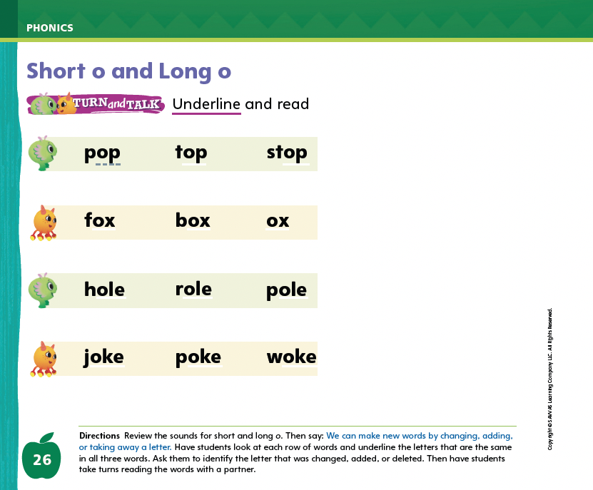
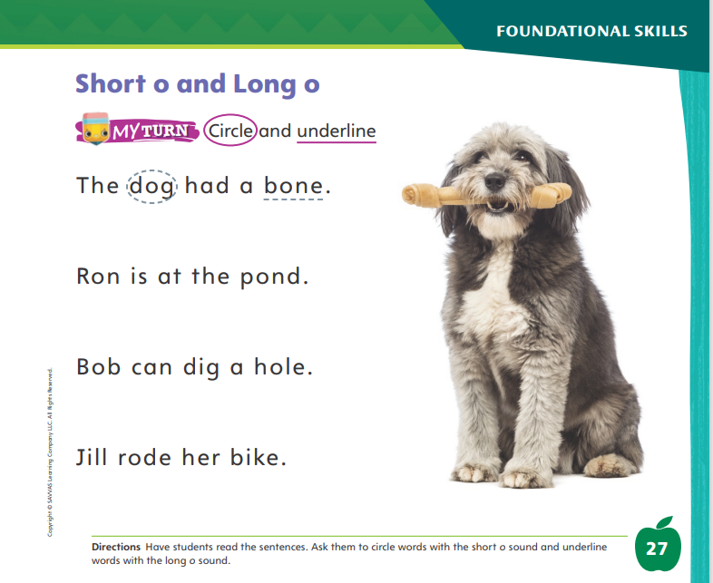
Page 26, 27
Apply
Turn to page 26, 27 in your Student Interactive and complete the activity.
Notes:
Have students turn to p. 26 in the Student Interactive and read the words with a partner. Have them underline the letters in each row that are the same and identify the letters that were changed, added, or deleted.
Have students turn to p. 27 in the Student Interactive. Have them read the sentences.
Ask them to circle words with the sound /o/ and underline words with the sound /ō/.

Slide 68
High-Frequency Words
find
over
again
Notes:
Remind students that high-frequency words are words that appear over and over in texts. Tell students that they will be learning many new words this year. Recognizing that some words are used more frequently will help students become better readers.
Say the word find and ask students what letters spell the word. Have students
Say the letters for the word as you write them on the board.
Say and spell the word, tapping their arm for each letter.
Repeat with over and again.

Slide 69
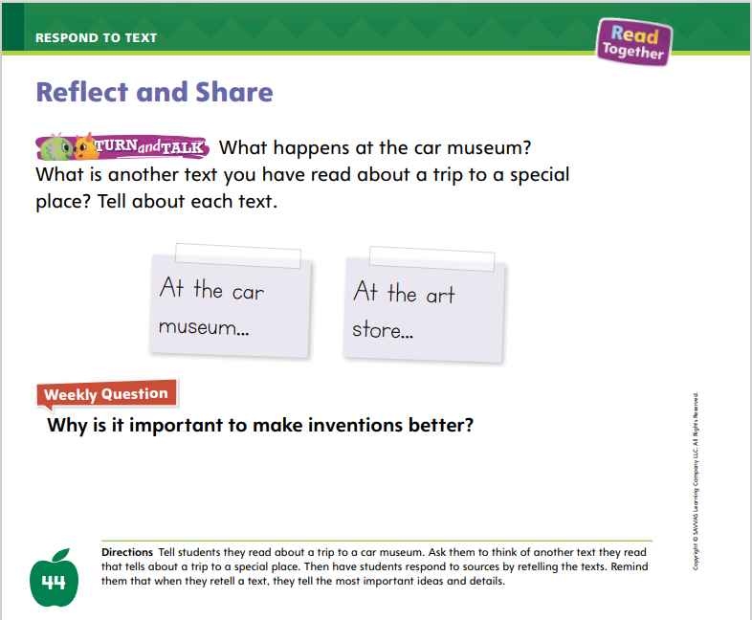
Page 44
Reflect and Share
Turn to page 44 in your Student Interactive. Talk to your partner about what happens at the car museum.
Notes:
Explain to students that readers often talk about the texts they have read. They may tell how other texts they have read are similar or different. They may also talk about how the text they read relates to their personal experiences. Remind students that they have read different texts about changing technology. Prompt them to make connections between different texts they have read. To talk about a text, students should:
Think about the main idea or theme of each text.
Think about which details are most important and why.
Ask: What was something I learned from the text?
Share ideas by speaking loudly and clearly using complete sentences.
Model talking about and comparing texts by retelling important details from Cars Are Always Changing and the infographic “Making Communication Better” in a way that maintains the meaning of each text and shows how they are similar. Say: Cars Are Always Changing is about going to a car museum to see how cars have changed over time. “Making Communication Better” is about technology we use to communicate. Both texts tell how technology changes things.
Have students turn to p. 44 of the Student Interactive. Read aloud the Turn and Talk prompt. Have partners talk about the texts.

Slide 70

Page 44
Apply
Why is it important to make inventions better?
Draw or write your response.
Notes:
Have students write or draw to respond to the Weekly Question.
Encourage them to share examples from the texts they have read and their own experiences.

Slide 71
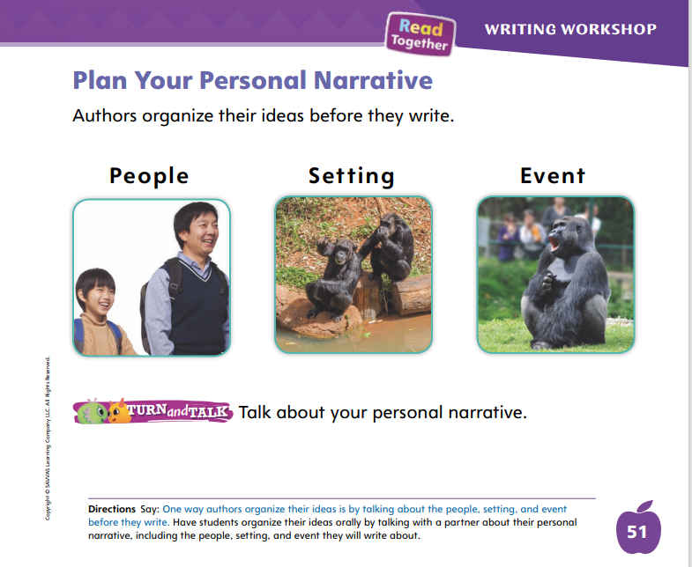
Page 51
Writing – Personal Narrative
Turn to page 51 in your Student Interactive.
Notes:
Authors plan the events for their personal narratives before they write them. Planning out the story helps an author think through the setting, characters, plot, and details. During the planning stage, authors might talk through the story before writing it.
Model planning your personal narrative by saying your story idea out loud. I have lots of ideas, but I need to choose the idea that my friends would enjoy reading about the most. I think the story about my first pet will be the most entertaining. Listen as I say my story out loud. One day I visited my cousin at his house. His hamster just had babies! There were four baby hamsters. I liked the white one best. I helped my cousin give the hamsters food and water. Then we watched the baby hamsters play. When we were leaving, my cousin asked me if I wanted one of the hamsters. I asked my mom, but she said no. She said we don’t have a cage and food. We wouldn’t be able to take care of it. I was sad. We went home and ate spaghetti for dinner. The next day, when I got home from school, my mom told me she had a surprise waiting for me. On the kitchen table, there was a cage with the white baby hamster inside! I was so excited to have a pet of my own.
Ask students if they have any questions about your story. Then tell them about some things you would change now that you have said it aloud (e.g., leaving out the detail about spaghetti; adding the cousin’s name). Now I’m ready to write down my story.
Direct students to p. 51 in the Student Interactive to help them plan their personal narrative. Have them tell their story to a partner. Use the pictures on the page to remind them that they should tell about the people, setting, and events in their story.

Slide 72
Spelling
The mop is in the corner.
The clown had a dot on his tie.
Turn the book over to see the title.
I hop when I play jump rope.
Put the old toys in the box.
I need to find my missing sock.
Notes:
(Note: Move the orange boxes to cover each bold spelling word before you read aloud the words and sentences.)
Read aloud the words and sentences. Have students spell each word with initial consonant blends and the two high-frequency words.
The mop is in the corner.
The clown had a dot on his tie.
Turn the book over to see the title.
I hop when I play jump rope.
Put the old toys in the box.
I need to find my missing sock.
Reveal the spelling word and have students check their work.

Slide 73
Language and Conventions
Two children play in the park.
Which words are the naming part and the action part?
Two, park
play, Two
children, play
children, park
Notes:
Display the sentence: Two children play in the park. Read aloud the sentence and then the question and answer choices below.
Which words are the naming part and the action part?
Two, park
play, Two
children, play
children, park
Have students complete Language and Conventions, p. 216 from the Resource Download Center. Click path: Table of Contents -> Resource Download Center -> Language and Conventions -> U4 W1

Slide 74
Unit 4: Week 1
Grade K

